Slide 1


Preparing to Implement a Climate Smart Agriculture and Forestry Strategy – Science and Data Needs
FCSM
November 3, 2021
Mindy Selman

Slide 2

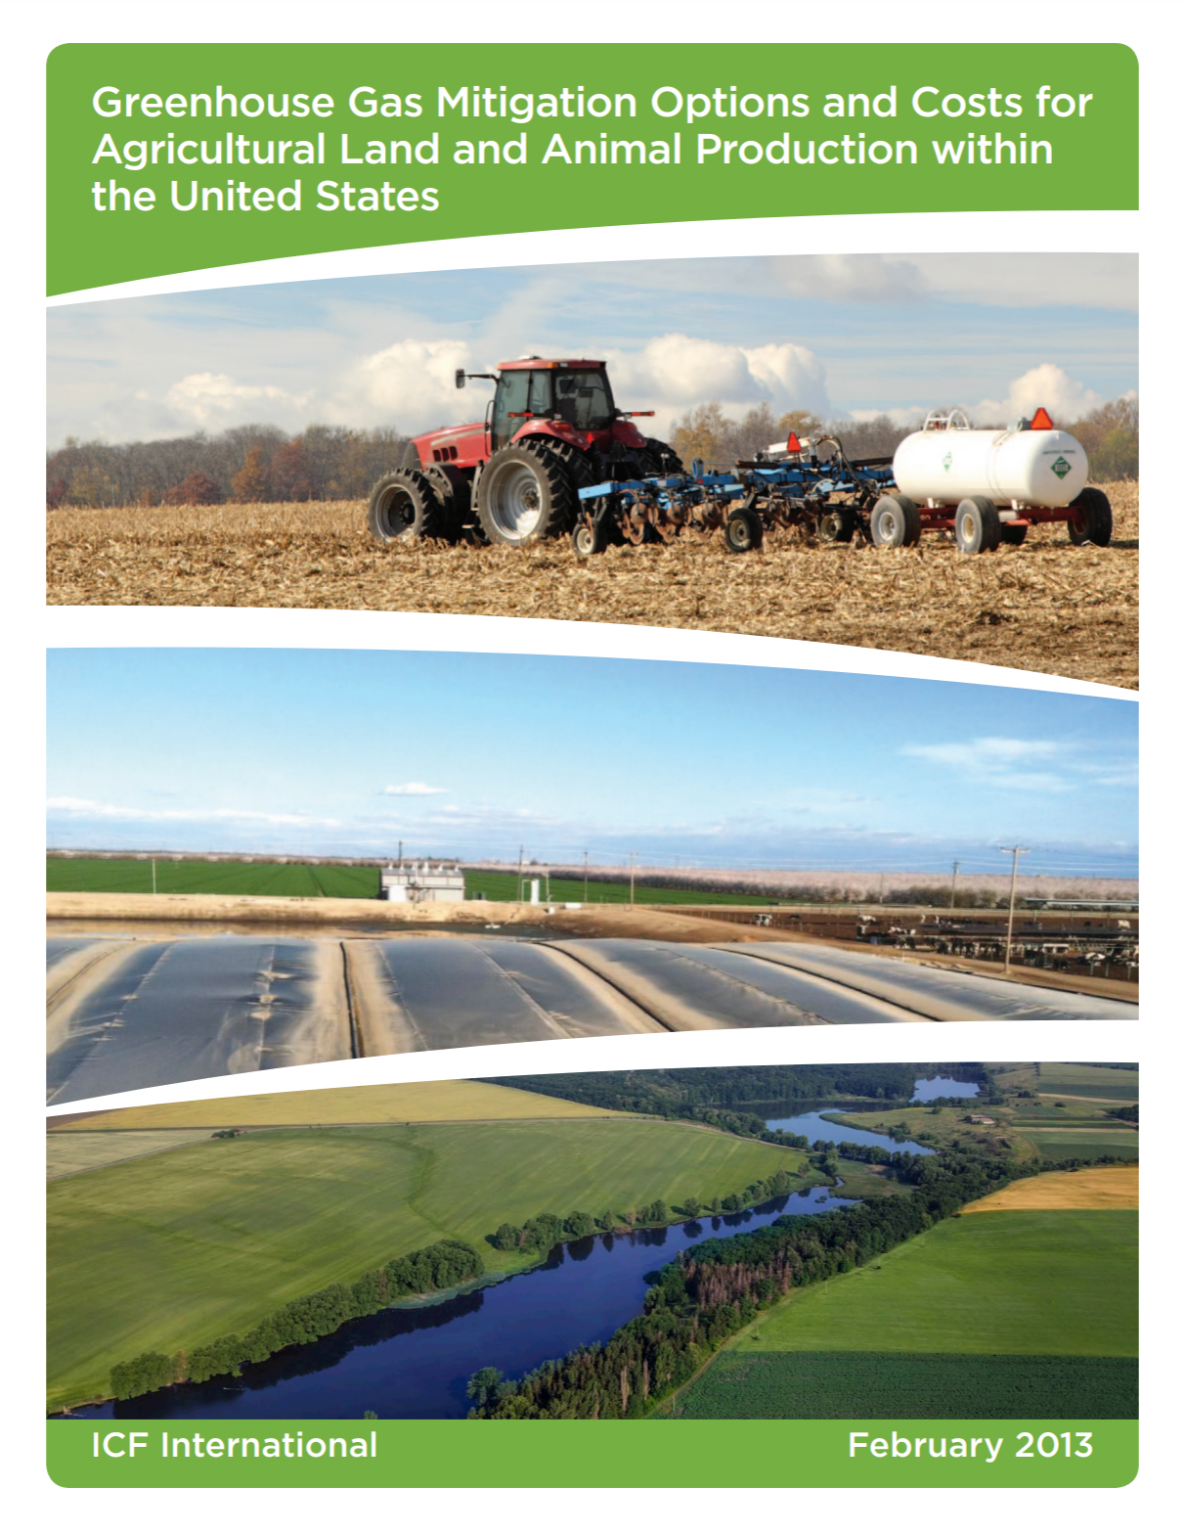
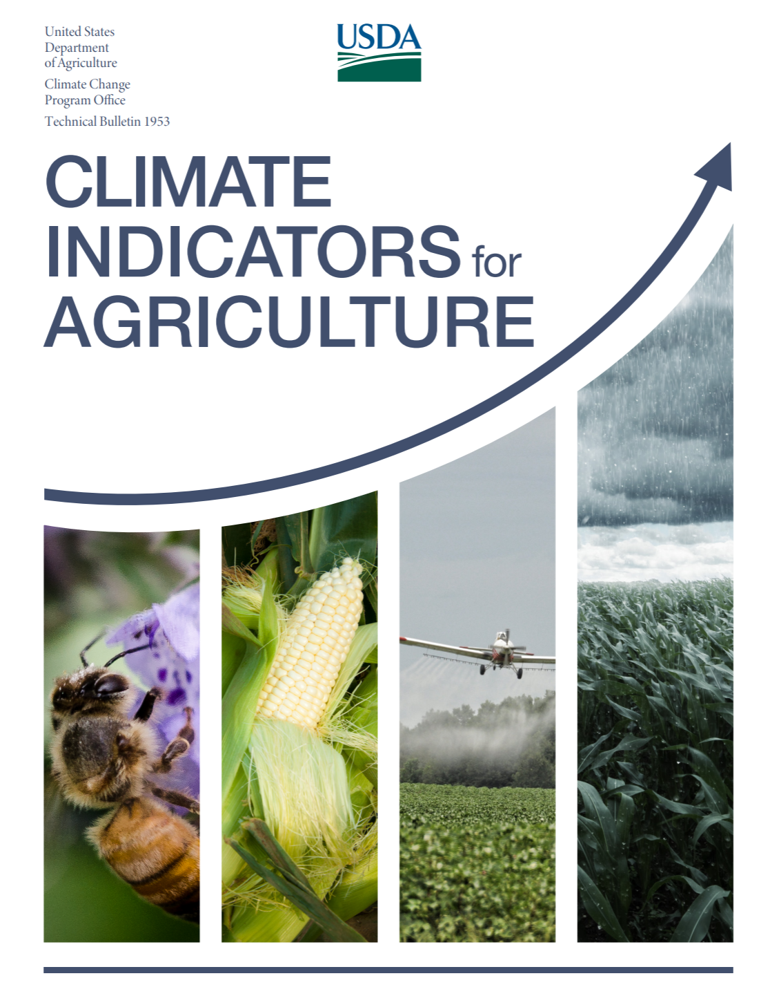
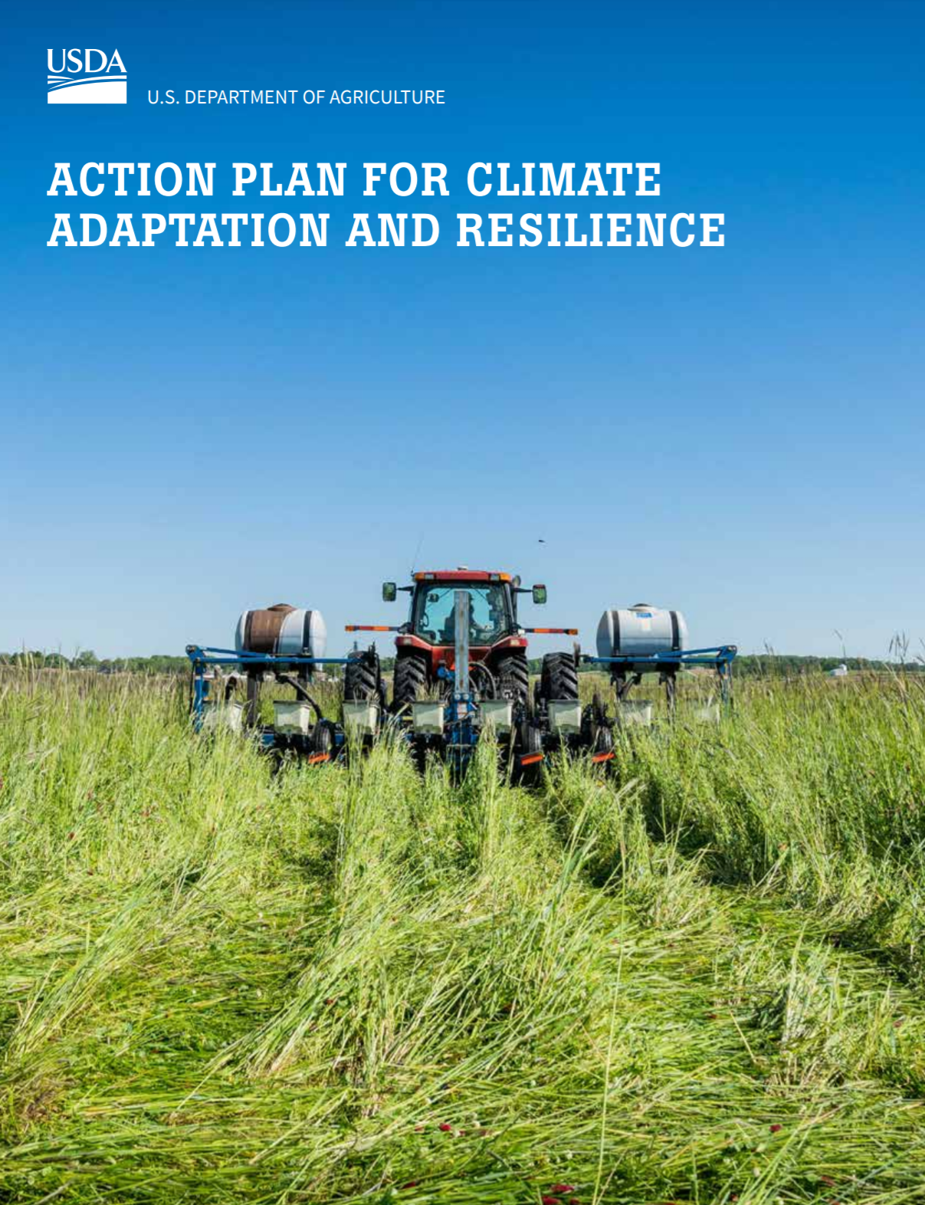
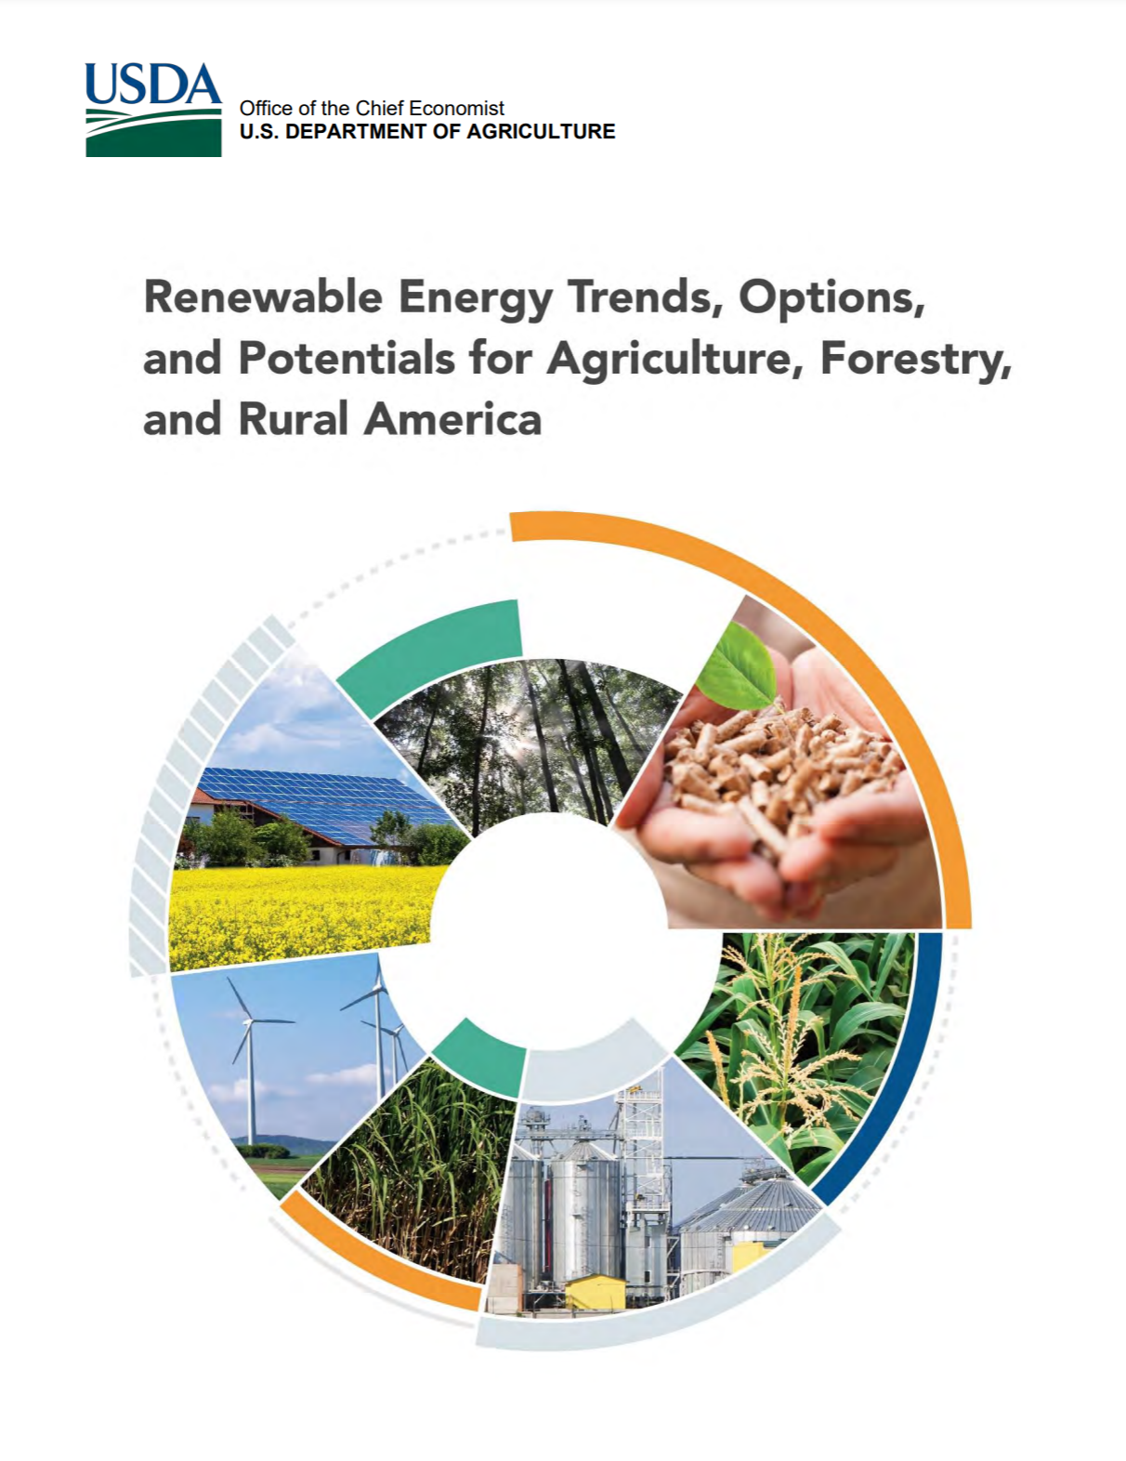
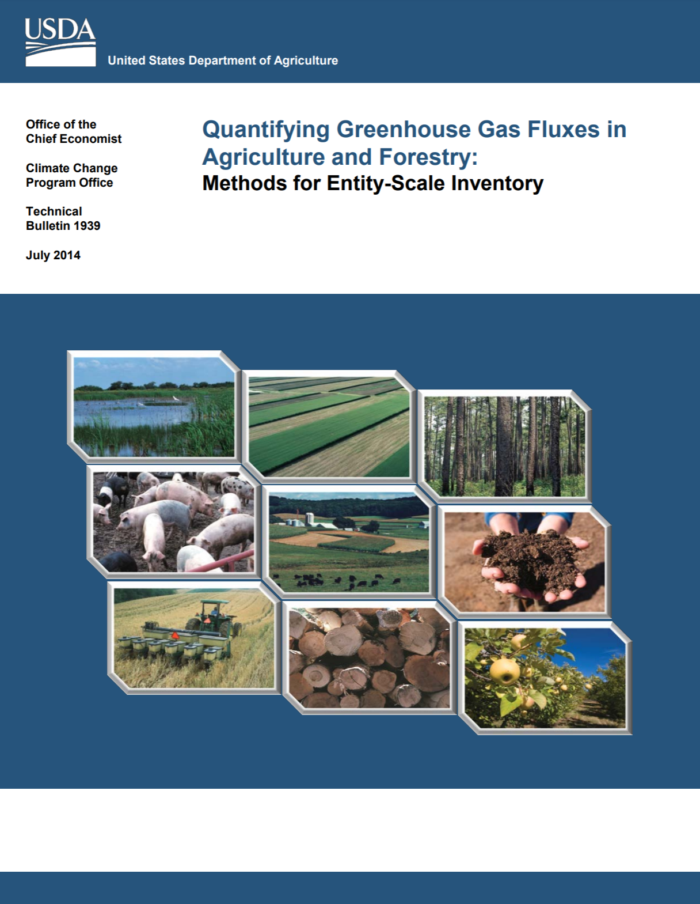
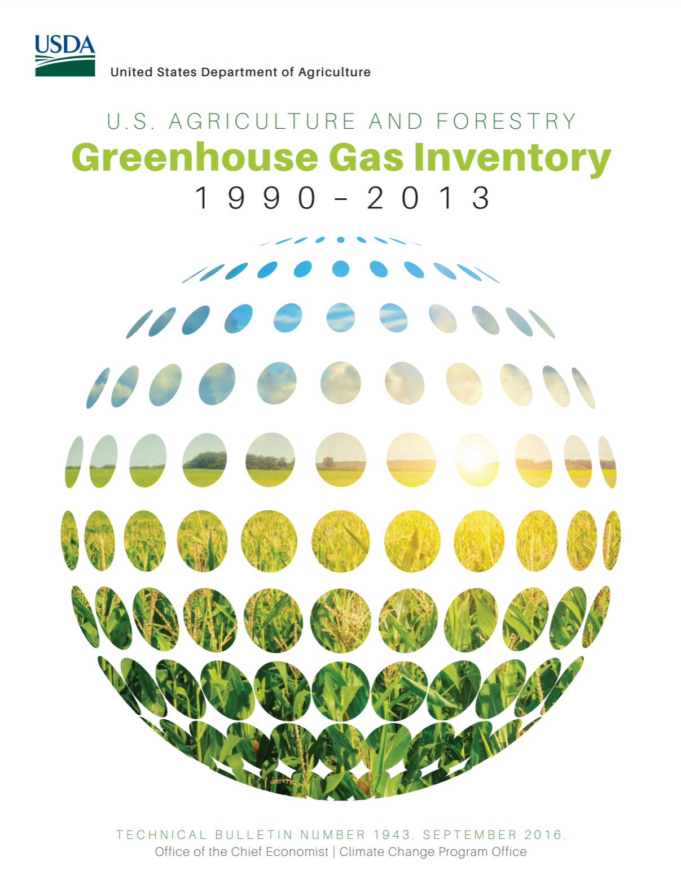
About OEEP
Coordinate climate work across the department
US GHG Inventory
Methods Report
Tools (COMET-Farm/COMET-Planner)
Models (DayCent)
Respond to requests for WH and Congress on climate change issues
Leading the “readiness” strategy for implementing USDA’s Climate Smart Ag and Forestry Strategy

Slide 3
Executive Order 14008
On January 27, 2021, President Biden signed Executive Order 14008 Tackling the Climate Crisis at Home and Abroad
This EO directs Federal agencies to coordinate a government-wide approach to combat the climate crisis
In this EO, USDA was tasked with delivering a report with recommendations for a climate-smart agricultural and forestry (CSAF) strategy within 90 days
USDA was also directed to consider CSAF practices that decrease wildfire risk fueled by climate change, source sustainable bioproducts and fuels, and result in conservation actions that provide measurable carbon reductions and sequestration

Slide 4
What is Readiness?
Readiness includes the data, science, tools and metrics needed to quantify and track benefits of our CSAF policies, and progress towards national GHG targets.
Readiness Needs:
Identify CSAF practices
Appropriate science and methods to quantify benefits of these practices
Sound models and tools (based on science) to support quantification at farm, program and national levels.
Survey data to track adoption at National Scale
Reporting
The GHG Inventory and Assessment Program is being stood up within OEEP to coordinate this work across the department.

Slide 5
Quantifying and Tracking GHG Benefits of Agriculture at Various Scales
Activity Data
Data on adoption of CSAF practices that result in GHG emissions or removals
National Scale
Activity data collected through national surveys
Program Scale
Program-level activity data
Emission Factor
Average GHG emission rate relative to units of a specific activity
National Scale
State-of-the-science models and methods used to estimate GHG sources and sinks in the ag sector.
Program Scale
Program-level GHG benefits.
Emission Estimate
Quantified estimate of GHG emissions or removals,
National Scale
Sector-wide GHG emissions
Program Scale
Emission factors developed through meta-model approach may be applied at a disaggregated scale and summed to program level
Farm Scale
Farmer-supplied activity data
Farm Scale
Field-scale tools used to estimate GHG emissions/ sequestration (e.g., COMET)
Farm Scale
Field/farm-level GHG impacts
Metrics/
Reports
Science, Research, Models and Methods
Science and research that helps determine the relationship between technologies and mitigation potential is used to improve models and develop standardized methods for estimation.
National Scale
Annual US GHG Inventory report Sinks
Program Scale
Climate dashboard, Justice 40 metrics, Hill requests

Slide 6
Quantifying and Tracking GHG Benefits of Agriculture at Various Scales
Activity Data
Data on adoption of CSAF practices that result in GHG emissions or removals
National Scale
Activity data collected through national surveys
Program Scale
Program-level activity data
Emission Factor
Average GHG emission rate relative to units of a specific activity
National Scale
State-of-the-science models and methods used to estimate GHG sources and sinks in the ag sector.
Program Scale
Program-level GHG benefits.
Emission Estimate
Quantified estimate of GHG emissions or removals,
National Scale
Sector-wide GHG emissions
Program Scale
Emission factors developed through meta-model approach may be applied at a disaggregated scale and summed to program level
Farm Scale
Farmer-supplied activity data
Farm Scale
Field-scale tools used to estimate GHG emissions/ sequestration (e.g., COMET)
Farm Scale
Field/farm-level GHG impacts
Metrics/
Reports
Science, Research, Models and Methods
Science and research that helps determine the relationship between technologies and mitigation potential is used to improve models and develop standardized methods for estimation.
National Scale
Annual US GHG Inventory report Sinks
Program Scale
Climate dashboard, Justice 40 metrics, Hill requests

Slide 7
OEEP Readiness Work and Related Needs
Conservation activity data gaps and needs
Improving the GHG Inventory
Improving science and models
Estimates of GHG benefits of USDA programs

Slide 8
Quantifying and Tracking GHG Benefits of Agriculture at Various Scales
Activity Data
Data on adoption of CSAF practices that result in GHG emissions or removals
National Scale
Activity data collected through national surveys
Program Scale
Program-level activity data
Emission Factor
Average GHG emission rate relative to units of a specific activity
National Scale
State-of-the-science models and methods used to estimate GHG sources and sinks in the ag sector.
Program Scale
Program-level GHG benefits.
Emission Estimate
Quantified estimate of GHG emissions or removals,
National Scale
Sector-wide GHG emissions
Program Scale
Emission factors developed through meta-model approach may be applied at a disaggregated scale and summed to program level
Farm Scale
Farmer-supplied activity data
Farm Scale
Field-scale tools used to estimate GHG emissions/ sequestration (e.g., COMET)
Farm Scale
Field/farm-level GHG impacts
Metrics/
Reports
Science, Research, Models and Methods
Science and research that helps determine the relationship between technologies and mitigation potential is used to improve models and develop standardized methods for estimation.
National Scale
Annual US GHG Inventory report Sinks
Program Scale
Climate dashboard, Justice 40 metrics, Hill requests

Slide 9
A Case for Improved Activity Data:
GHG Estimates are Only as Good as the Underlying Data

Slide 10
National-level Activity Data Gaps
Timeliness of data collection (e.g., CEAP every 10 years)
Data connectivity and interoperability (e.g., lack of consistent location data, crop vs. field, inconsistent links through NASS list-frame)
Data analysis and release of statistics
Insufficient national adoption data on certain activities including agroforestry, pasture/range practices, manure management and animal diets.

Slide 11
Recommended Improvements to Activity Data
We have identified the following recommendations for improving conservation data:
Develop a new survey instrument(s), e.g. for pasture/range, manure and feed management.
Leverage satellite technologies to track adoption of some practices (e.g., tillage, cover crops, etc.)
Add/modify questions on existing surveys to fill activity data gaps.
Improve timeliness of CEAP data.
Use industry data where available to determine adoption rates of emerging technologies (e.g., biochar, EEFs)
Improve linkages between existing surveys to fill time gaps

Slide 12
Quantifying and Tracking GHG Benefits of Agriculture at Various Scales
Activity Data
Data on adoption of CSAF practices that result in GHG emissions or removals
National Scale
Activity data collected through national surveys
Program Scale
Program-level activity data
Emission Factor
Average GHG emission rate relative to units of a specific activity
National Scale
State-of-the-science models and methods used to estimate GHG sources and sinks in the ag sector.
Program Scale
Program-level GHG benefits.
Emission Estimate
Quantified estimate of GHG emissions or removals,
National Scale
Sector-wide GHG emissions
Program Scale
Emission factors developed through meta-model approach may be applied at a disaggregated scale and summed to program level
Farm Scale
Farmer-supplied activity data
Farm Scale
Field-scale tools used to estimate GHG emissions/ sequestration (e.g., COMET)
Farm Scale
Field/farm-level GHG impacts
Metrics/
Reports
Science, Research, Models and Methods
Science and research that helps determine the relationship between technologies and mitigation potential is used to improve models and develop standardized methods for estimation.
National Scale
Annual US GHG Inventory report Sinks
Program Scale
Climate dashboard, Justice 40 metrics, Hill requests

Slide 13
Recommended Inventory Improvements
Return to annual agricultural GHG updates
Invest in timely surveys of conservation practices
Inventory investments should reflect annual changes in on-farm management to demonstrate the benefits of increased adoption of conservation activities.
Improve use of existing USDA survey data (esp. ARMS data) within the Inventory
Implement inventory improvements in agriculture and forestry sectors, e.g., including Alaska and accurately estimating carbon stock change, capturing above-ground biomass in the agriculture inventory, etc.

Slide 14
Quantifying and Tracking GHG Benefits of Agriculture at Various Scales
Activity Data
Data on adoption of CSAF practices that result in GHG emissions or removals
National Scale
Activity data collected through national surveys
Program Scale
Program-level activity data
Emission Factor
Average GHG emission rate relative to units of a specific activity
National Scale
State-of-the-science models and methods used to estimate GHG sources and sinks in the ag sector.
Program Scale
Program-level GHG benefits.
Emission Estimate
Quantified estimate of GHG emissions or removals,
National Scale
Sector-wide GHG emissions
Program Scale
Emission factors developed through meta-model approach may be applied at a disaggregated scale and summed to program level
Farm Scale
Farmer-supplied activity data
Farm Scale
Field-scale tools used to estimate GHG emissions/ sequestration (e.g., COMET)
Farm Scale
Field/farm-level GHG impacts
Metrics/
Reports
Science, Research, Models and Methods
Science and research that helps determine the relationship between technologies and mitigation potential is used to improve models and develop standardized methods for estimation.
National Scale
Annual US GHG Inventory report Sinks
Program Scale
Climate dashboard, Justice 40 metrics, Hill requests

Slide 15
Improving Science and Models
Establish a soil health monitoring network
This network would provide reliable, representative, and spatially distributed soil data that would increase USDA’s ability to estimate the impact of management practices on soil organic carbon, soil erosion, water quality and a variety of other soil health metrics.
Establish a Center of Excellence
The Center of Excellence would be housed in ARS and would establish standardized methods for evaluating new climate-relevant technologies in addition to creating standards for data collection and reporting.
Update the GHG Methods report as needed
OEEP is currently undertaking an update of the GHG methods report for the agriculture sector. The forestry update will take place in 2022. These methods are used to update the DayCent model as well as other related methods and tools.

Slide 16
Quantifying and Tracking GHG Benefits of Agriculture at Various Scales
Activity Data
Data on adoption of CSAF practices that result in GHG emissions or removals
National Scale
Activity data collected through national surveys
Program Scale
Program-level activity data
Emission Factor
Average GHG emission rate relative to units of a specific activity
National Scale
State-of-the-science models and methods used to estimate GHG sources and sinks in the ag sector.
Program Scale
Program-level GHG benefits.
Emission Estimate
Quantified estimate of GHG emissions or removals,
National Scale
Sector-wide GHG emissions
Program Scale
Emission factors developed through meta-model approach may be applied at a disaggregated scale and summed to program level
Farm Scale
Farmer-supplied activity data
Farm Scale
Field-scale tools used to estimate GHG emissions/ sequestration (e.g., COMET)
Farm Scale
Field/farm-level GHG impacts
Metrics/
Reports
Science, Research, Models and Methods
Science and research that helps determine the relationship between technologies and mitigation potential is used to improve models and develop standardized methods for estimation.
National Scale
Annual US GHG Inventory report Sinks
Program Scale
Climate dashboard, Justice 40 metrics, Hill requests

Slide 17
Estimating GHG Benefits of Programs
GHG benefits of programs necessary for:
Tracking impacts of programs
Reporting towards GHG and Justice40 goals
Responding to WH and Hill requests
Needs include:
Agreed-upon accounting methods
Agreed-upon estimation methods
Institutionalization
Documentation
Next Steps:
OEEP will work with OCIO to establish a workgroup
Use NRCS as pilot for establishing method
Develop a dashboard to visualize data and serve as template for other agencies.

Slide 18
Mindy Selman
USDA Office of Energy and Environmental Policy
Mindy.Selman@usda.gov
Thank You!

